Slide 1
Self care, the Process of Change and the Mandala Stephen Buckbee

Slide 2
The thing that matters most is our ability to love. Shmuel Ron

Slide 3
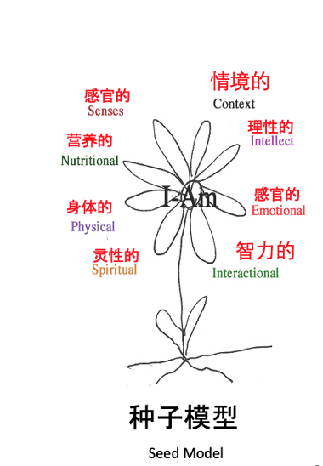
Satir on Change
The change process is the same every where.
The timing is different; the form is different but the process is identical.
The only certainty in life is change.
Most people prefer a miserable certainty to the misery of uncertainty.
Stressors are a normal part of every living thing

Slide 4
Trauma occurs when a person is exposed to unusual events of sufficient emotional power as to overcome the person’s usual coping ability.
The unusually strong emotional reactions that are activated can interfere with the ability to function physically, emotionally, cognitively and or behaviorally during the situation or later.
When stressful experiences accumulate, their impact can destroy or erode coping mechanisms. and serious physical disease can result.
Remember to breath…
Be prepared to not be prepared. Grounded, aware and sensitive.
Pace yourself and use your support team if you do not have one create one.
Trauma often triggers growth.
The past does not determine the future.

Slide 5
Types of Losses
Loss of Possessions-Home, Property, Car, Pets, Photos, Papers, Jewelry, Books
Developmental Losses- Coping with a history of regrets, The things that could have been but were never accomplished.
Loss of safety-
Loss of Self-Identity, privacy, independence, pride, senses, sexuality, memory, health, decision making, purpose, self respect, self worth.
Significant others- loved ones, friends age mates, family

Slide 6
Be aware of your vulnerabilities.
around each dimension.
You are an amazing human who
Has the ability to adapt so when triggered be aware and ground yourself.
How do we protect our vulnerabilities what stances do we use?
PHYSICAL
Disruption can occur at every dimension.
NUTRITIONAL
SPIRITUAL
AI A
I AM
SELF
INTELLECTUAL
CONTEXTUAL
Fear is not a bad thing.
Be there, listen, breath
EMOTIONAL
SENSUAL
Help people find a
Safe place.
INTERACTIONAL
Rules about commenting

Slide 7
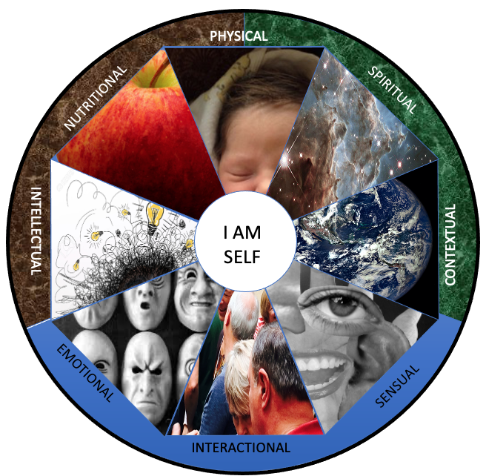
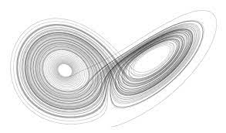
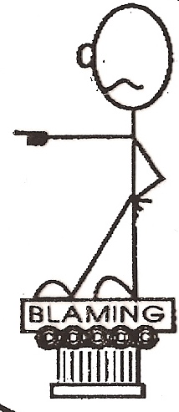
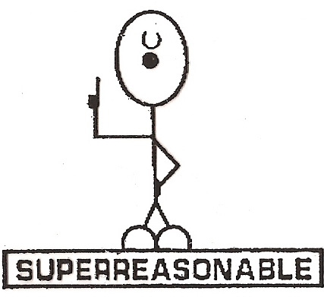
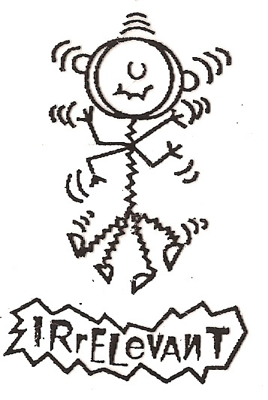
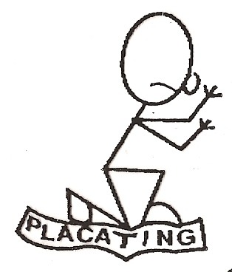
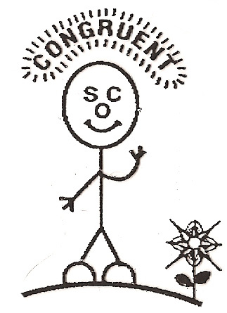
Status Quo
Chaos
Foreign Element
?
How do we deal with the chaos
What coping stance so you use?
CHOICE
Too Hard Not worth it. Does not feel like me
CHOICE
All choices involve loss
The desire to move back to the old Status Quo is normal
New Status Quo
新的学习
New Learning
Practice
练习
整合
integration

Slide 8
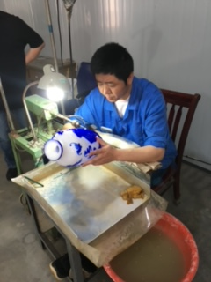
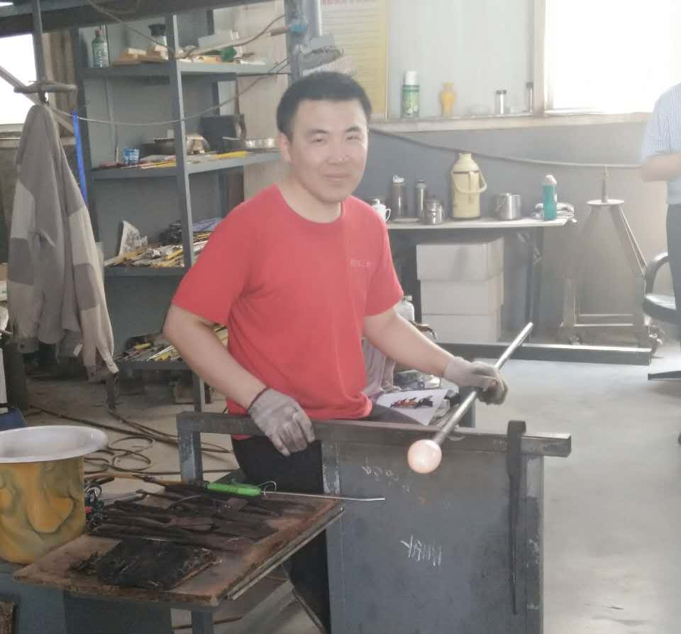
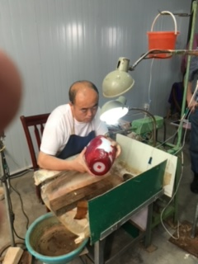
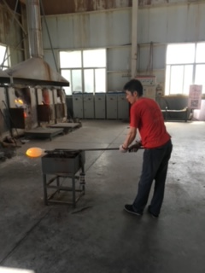

Slide 9
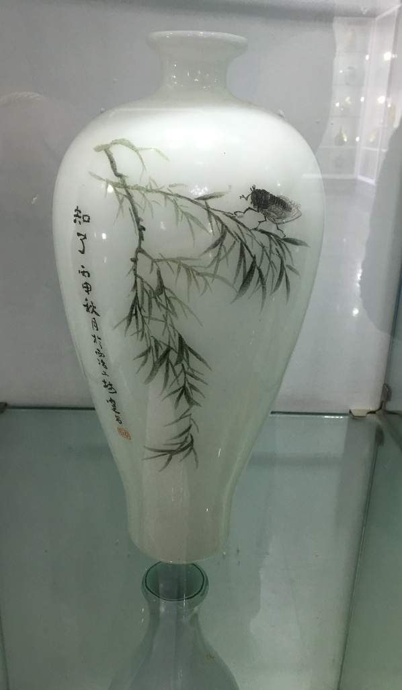

Slide 11
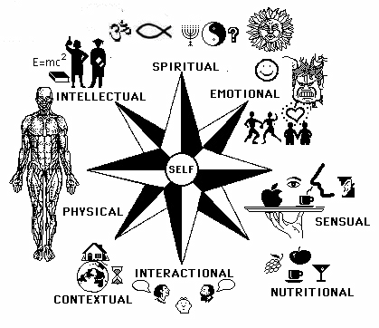
Signs and Symptoms of Stress Reactions
Cognitive Dimension
Confusion, nightmares, uncertainty, hyper-vigilance, suspiciousness, intrusive images, blaming someone, poor problem solving, poor abstract thinking, decisions poor concentration, memory, difficulty identifying objects or people heightened or
lowered alertness increased or decreased awareness of surroundings Cognitive Dissonance
Spiritual Dimension
Questions about the meaning of life. Feelings of spiritual abandonment. Existential Crisis.
Emotional
fear, guilt, grief, panic, denial, anxiety, agitation, irritability. depression, intense anger, apprehension, emotional shock, emotional outbursts, feeling overwhelmed, loss of emotional control, inappropriate emotional response, confusion.
Physical Dimension
Chills, thirst, fatigue, nausea, fainting, vomiting, dizziness weakness, chest pain headaches, elevated BP, rapid heart rate muscle tremors shock symptoms grinding of teeth, visual difficulties profuse sweating difficulty breathing etc. ..
Sensual Dimension
Hyper-alert to environmental changes,
Triggers each sensory channel can be fired.
Text
Contextual Dimension
Withdrawal, disconnecting from family, restlessness. change in sleep patterns, disorientation of time, place or person
Nutritional Dimension
Increased consumption of alcohol, food,
other substances not feeding the other
Dimensions. Loss of appetite.
Interactional Dimension
Questions about why this had to happen.
A tone of sadness, anger and irritability, becoming less talkative, change in social activity, changes in speech patterns, poor attention

Slide 12
Normal Reactions Following Trauma and Loss
Question Why this had to happen?
Sadness and missing a person
Need to talk about and remember the deceased
Anger and increased irritability
Guilt- a feeling of responsibility for action take or not take, or a feeling that “I survived when someone else did not.
Confusion/feelings are all mixed up
Shock, numbness, a belief that it did not really happen.
Feelings of loneliness or that no one understands. Social withdrawal
Fears (of dark, of being alone, etc.)
Loss of trust in people or in the world as a safe and fair place.
Sense of helplessness and loss of control
Expectations that other bad things may happen, possibly one’s own death.
Difficulty concentration and forgetfulness.
Questions about the meaning of life.
Concerns about the suffering of the deceased
Renewed memories of other’s losses or pain
Regression to more immature behaviors
Greater sensitivity and more emotional responses to everyday events.
A drop in grades of job performance months after the event.
Memories of the deceased as being perfect
Feels responsible for “filling the shoes” of the deceased (e.g. taking on behaviors or tasks of the deceased)
Flashbacks to feelings or memories of the traumatic events weeks or months later.
Desire to die or escape the pain
Physical symptoms ( e.g. Headaches, diarrhea dizziness, chest pains, or worsening or previous medical condition)
Eating or digestion problems
Excessive energy that’s difficult to channel or less energy than usual.

Slide 13
Reminders for dealing with your loss.
Recognize it,
For a while you may be numb. A death, a loss and accident has happened. Don’t try to avoid it.
You are not alone. Loss is part of life- everyone experiences it.
Give yourself time to heal. The greater the loss. The more time it will take. In many way au are like a convalescent right now. Don’t jump into new things too quickly.
Healing has its ups and downs. Healing is not a smooth progression but has both leaps and backslides
Take good care of you. Get plenty of rest. Eat right, stick to a schedule. Activity may give you a sense of order. You have experienced a significant loss. Treat yourself with care.
Seek comfort- Accept support from others, in fact, seek. It is human and courageous
Reaffirm and beliefs Use your faith right now. Explore it. Lean on it, Grow
Surround yourself with Living things. A new plant, a pet, a bowl of fresh fruit.
Keep decision making to a minimum. Your judgements may be clouded for a while. You are going through change which requires most of your strength
Weekend and holidays may be worst. Schedule activities you particularly enjoy during these times. Allow yourself to be with the pain and mourn now. Postponed grief can return later. Grief feelings will be expressed one way of another.
Mementos If these are helpful to you, use them. But if they bind you negatively to the past, get rid of them. Before you say hello, you must say good bye.
It is okay to feel depressed and or/ angry. Every on gets angry with loss and crying can be a cleansing release. Be with the feelings for a while; channel them appropriately and they will heal. Hit a pillow, run, scream when you are allowed; play hard.
Suicide thoughts These may arise because they are symptoms of pain. They will pass. If you feel they are getting out of control, GET HELP AT ONCE
You may feel vulnerable Your resistance may be low. Invite help only form those people you know to be trustworthy.
Focus on those things that you can control.

Slide 14
Mandala resources
Intellectual· new challenges/pursuits· read something new· write- book, diary, letters, journal· analyze and understand· Overcome mental- blocks· evaluate/reorganize goals· educational TV or radio· get involved with others· recognize the loss
Spiritual· prayer· meditation· values clarification· refusing to judge· sharing grief· acceptance of self and others· personal reflection time· making commitments· worship
Emotional· accept self· sort out conflicts· restructure internal dialogue· positive self-talk· desensitize worry & anxiety· change expectations· anger management strategies· discipline· successful changes· accept vulnerability
Physical· improve physical habits· accept limits· slow down· relaxation training· exercise physical exam· proper sleep· sex· sober/drug free , pay attention and listen.
Sensual· listen to music· bubble bath, perfume· massage· see a movie,· art gallery,· flowers· learn detachment· meditation· learn guided fantasy· chocolate or other pleasing taste.
Contextual· time management strategies· take a walk· find safe places/people· slow down· search for the good in your situation· rearrange your furniture/paint the house· get a makeover·visit a new place· mementos
Nutritional· It is the way we connect in most cultures.;”Have some tea”/healthy eating pattern· moderate use of mood altering chemicals or abstinence· proper medications· vitamins· listen to your body· Understand that you need to feed all of your dimensions.
Interactional· find trustworthy friends· become a risk-taker· assertiveness training· therapy/discussion/interest group· reach out to others· learn and practice communication techniques· improve self-esteem· accept others as they are
Self care is for everyone
Keep and eye on your heart.
Normalize as much as possible
recognizing the context. Focus on resources .
Talk to some one, debrief.

Slide 15
The Five Freedoms
The FREEDOM to see and hear what is here, instead of
what should be, was, or will be.
The FREEDOM to say what you feel and think,
instead of what you should.
The FREEDOM to feel what you feel, instead of what you ought.
The FREEDOM to ask for what you want, instead of always
waiting for permission.
The FREEDOM to take risks in your own behalf, instead of
choosing to be only "secure" and not rocking the boat.
Virginia Satir
Take only what fits and what does not fit put it aside and move on.

Slide 16
https://www.ready.gov/coping-disaster
https://www.samhsa.gov
https://www.psychiatry.org/patients-families/coping-after-disaster-trauma
https://www.selfcareforum.org

Slide 17
Sin Eaters & healing
In some part of Wales a very extraordinary rite was observed. "When a person died, the friends sent for the sin-eater of the district, who on his arrival places a piece of salt on the breast of the defunct, and upon the salt a piece of bread. He then muttered an incantation over the bread, which he finally ate; thereby eating up all the sins of the deceased. This done, he received the fee of two shillings and sixpence, and vanished as quickly as possible from the general gaze; for as it was believed that he really appropriated to his own use and beheld the sins of all those over whom he performed the above ceremony, he was utterly detested in the neighborhood -- regarded as a mere Pariah -- as one irremediably lost."
You are not a Sin Eater
You are the elements of change.
You are witnesses to hungers of others.

Slide 18
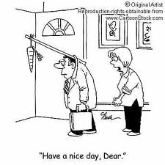
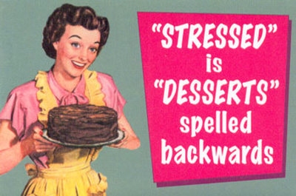
CUMULATIVE STRESS
Cumulative stress is a state of chronic fatigue and frustration resulting from many disappointments and unrelieved stress. It is sometimes referred to as "burnout" and is difficult to differentiate from clinical depression. Signs and symptoms of cumulative stress include the following:
• Depression
• Fatigue
• Irritability
• Apathy and disillusionment
• Excessive defensiveness and withdrawal
• Increased use of alcohol and drug abuse
• Loss of energy
• Increased illness

Slide 19
